Slide 1


“Library Management System with RFID Integration. ”
A Project Report Submitted in the partial fulfillment of the requirements for the Library Management System with RFID Integration award of the degree of
BACHELOR OF TECHNOLOGY
In
DEPARTMENT OF COMPUTER SCIENCE AND INFORMATION TECHNOLOGY
By
Bachu Siddhartha
2500090225
V.Santosh
2520090051
Under the Esteemed Guidance of
Khaja Shareef
CS&IT HOD
Department of Computer Science and Information Technology

Slide 2
K L (Deemed to be) University
DEPARTMENT OF COMPUTER SCIENCE AND INFORMATION TECHNOLOGY
Declaration
The Project Report entitled “Library Management System with RFID Integration” is a record of bonafide work of BACHU SIDDHARTA-2500090225, V.SANTOSH- 2520090051,C.V.JASHWANTH REDDY-2520080025 submitted in partial fulfillment of the requirements of the course DATABASE SYSTEMS ENGINEERING AND DISTRIBUTED BACKEND DEVELOPMENT (25CS1302E), Section 12, Team 22, during 2026–2027, Trimester 4, at KLH University. The results embodied in this report have not been copied from any other student, department, or institution.
BACHU SIDDHARTHA– 2500090225
V.SANTOSH – 2520090051
V.JASWANTH REDDY-2520080025

Slide 3
K L (Deemed to be) University
DEPARTMENT OF COMPUTER SCIENCE AND INFORMATION TECHNOLOGY
CERTIFICATE
This is to certify that the project report entitled “Library Management System with RFID Integration” is a bonafide work done and submitted by BACHU SIDDHARTHA – 2500090225, V.SANTOSH – 2520090051,C.V.JASHWANTH-2520080025. in partial fulfillment of the requirements of the course DATABASE SYSTEMS ENGINEERING AND DISTRIBUTED BACKEND DEVELOPMENT (25CS1302E), Section 10, Team 1, at KLH University
during 2026–2027, Trimester 4.
Signature of the Guide
Signature of the Course Coordinator
Signature of the HOD

Slide 4
ACKNOWLEDGEMENT
The success in this project would not have been possible but for the timely help and guidance rendered by many people. Our wish to express my sincere thanks to all those who has assisted us in one way or the other for the completion of my project.
Our greatest appreciation to my Course Coordinator Dr , and my guide Dr. Kaja Shareef, Department of Computer Science and Information Technology which cannot be expressed in words for his/her tremendous support, encouragement and guidance for this project.
We express our gratitude to Dr. Kaja Shareef, Head of the Department for Computer Science and Information Technology for providing us with adequate facilities, ways and means by which we are able to complete this project-based Lab.
We thank all the members of teaching and non-teaching staff members, and also who have assisted me directly or indirectly for successful completion of this project. Finally, I sincerely thank my parents, friends and classmates for their kind help and cooperation during my work.
BACHU SIDDHARTHA– 2500090225
V.SANTOSH – 2520090051
V.JASWANTH REDDY-2520080025

Slide 5
Abstract
The Library Management System with RFID Integration is a full-stack web-based application designed to help libraries efficiently manage books, members, book circulation, fines, inventory, and library-related activities. Traditional library management can involve separate and manual record-keeping for books, members, issue and return transactions, and fines, which may lead to difficulties in maintaining accurate and up-to-date information. The proposed system provides a centralized platform to simplify these operations and improve the management of library resources.
The system provides a user-friendly web interface through which librarians can manage books and members, issue and return books, monitor fines, verify inventory, and access reports. Students can browse available books and view their own borrowed books, fines, and profile information. The system also includes a software-based RFID simulator that demonstrates how RFID identification can be integrated into the book issue and return process. Role-based access is provided for administrators, librarians, and students, ensuring that users can access only the operations appropriate to their roles.
The application uses a React-based frontend with Vite, Node.js and Express.js backend, and a MySQL relational database for storing and managing system information. The backend provides REST APIs through which the frontend communicates with the database using mysql2. The database maintains relationships between users, books, members, transactions, and fines using primary keys and foreign keys. Authentication and security are supported using JWT and bcrypt, while CORS enables communication between the frontend and backend. The system is developed to provide dynamic dashboard statistics, centralized data management, automated issue and return tracking, fine management, inventory verification, and RFID-based identification simulation. By integrating these functions into a single platform, the system aims to improve library resource management, reduce manual record-keeping, and provide better visibility into book availability and circulation.

Slide 6
Index
S.No. | Chapters | Topics | Page No.
 |  | Acknowledgement
 |  | Abstract
1 | Introduction | Background of the Project Problem Statement Scope of the Project Objectives Importance of the Application Target Users / Audience | 5
2 | System Requirements | Hardware Requirements Software Requirements Development Tools and Frameworks | 7
3 | Technology Stack | Frontend Backend Database Version Control Authentication and Security Libraries | 8
4 | System Architecture | High-Level Architecture Diagram Description of Each Layer Deployment Architecture | 9
5 | Design | Database Design Principles ER Diagram / Database Schema Design Decisions and Assumptions | 10
6 | Implementation | Module-wise Implementation Front-end Logic API Integration Authentication and Authorization | 12
7 | Features | List of Main Features How Each Feature Works | 13
8 | Testing | Postman API Testing Integration Testing Tools Used for Testing Test Cases and Results | 15
9 | Deployment | Steps to Deploy Environment Configuration Hosting of Frontend and Backend | 17
10 | Challenges & Limitations | Issues Faced During Development Solutions Applied Current Limitations or Known Bugs | 18

Slide 7
S.No. | Chapters | Topics | Page No.
11 | Future Enhancements | Planned Features Possible Integrations or Optimizations | 19
12 | Conclusion | Summary of the Project What Was Achieved Skills Learned | 20
13 | References | – Documentation, tools, and resources used | 21
14 | Appendices | Sample Code Snippets Installation / Setup Instructions Default Login Credentials API Reference Summary Screenshots (to be added by the student) | 22

Slide 8
CHAPTER
-1 INTRODUCTION
  Background of the Project
Libraries routinely manage a large number of books, students, issue and return transactions, fines, and inventory records. In many libraries, these activities may be coordinated through manual registers, spreadsheets, or separate records. This can work when the number of books and users is small, but becomes difficult as library usage increases, leading to problems such as outdated availability information, difficulty tracking borrowed books, errors in fine records, and inefficient inventory management.
The Library Management System with RFID Integration was built to replace this fragmented management with a single, database-backed source of truth. Every book, member, transaction, and fine is stored in a centralized MySQL database, while the system provides a web interface for managing these records. The system can track whether a book is available or issued, associate transactions with members, manage returns and fines, and provide dashboard statistics. A software-based RFID simulator is also included to demonstrate how RFID identification can be integrated into the issue and return process, while role-based access allows administrators, librarians, and students to access the functions relevant to them.
  Problem Statement
Libraries manage a large number of books, students, issue and return transactions, fines, and inventory records. When these activities are handled through manual registers, spreadsheets, or separate records, it becomes difficult to maintain accurate and up-to-date information about book availability, borrowed books, due dates, fines, and inventory. This can lead to outdated records, duplicate entries, and inefficient library operations.
The Library Management System with RFID Integration addresses these problems by providing a centralized, database-backed system for managing books, members, transactions, and fines. The system maintains accurate book availability, tracks issue and return activities, manages fines, and provides role-based access for administrators, librarians, and students. A software-based RFID simulator is also included to demonstrate RFID-based book identification during library operations.
  Scope of the Project
The system covers the major operations of a library, including adding and managing books and members, checking book availability, issuing and returning books, maintaining transaction records, managing fines, verifying inventory, and viewing reports and dashboard statistics. The system also includes a software-based RFID simulator for identifying books and demonstrating RFID-assisted circulation. Role-based access is provided for administrators, librarians, and students, while students are restricted to viewing their own library information. Physical RFID hardware integration is considered outside the scope of the current implementation.
  Objectives
Provide a centralized system for managing books, members, transactions, fines, and inventory.
Provide up-to-date information about book availability and circulation status.
Maintain accurate records for book issue, return, due dates, and applicable fines.

Slide 9
Secure the system with role-based access, so student accounts can never reach admin-only functionality.
  Importance of the Application
By centralizing book, member, transaction, and fine information, the system reduces the difficulties associated with manual library management. Librarians gain a clear view of book availability, issued books, returns, fines, and inventory, allowing them to manage library resources more efficiently. Students can check available books, view their borrowed books and fines, and access their profile without depending entirely on library staff. The software RFID simulator also demonstrates how RFID-based identification can be incorporated into library circulation.
  Target Users / Audience
  The system primarily serves three roles: administrators, librarians, and students. Students use the system to browse available books, view their borrowed books, check their fines, and access their profile. Librarians use it to manage books and members, issue and return books, perform RFID operations, manage fines, verify inventory, and access reports. Administrators have overall management access to the library system and can control the appropriate administrative operations.

Slide 10
CHAPTER 2: SYSTEM REQUIREMENTS
  Hardware Requirements
The application has modest hardware requirements because the React frontend, Node.js backend, and MySQL database can all run on a standard development computer. A computer with a dual-core processor, at least 4 GB of RAM, and sufficient free storage for the project files, Node.js modules, and MySQL database is suitable for developing and demonstrating the Library Management System. The system does not currently require physical RFID hardware because the project uses a software-based RFID simulator.
  Software Requirements
Node.js 18 or later, with npm
MySQL 8.0 or later
A modern web browser such as Chrome, Edge, or Firefox
Git and GitHub for version control
Visual Studio Code for development
MySQL Workbench for managing and verifying the database
Postman for testing REST APIs
2.3 Development Tools and Frameworks
React.js with Vite is used to develop the frontend of the Library Management System, providing the user interface for administrators, librarians, and students. Node.js with the Express.js framework is used to develop the backend REST APIs and handle application logic. MySQL is used as the relational database for storing books, members, users, transactions, and fines, while the mysql2 driver enables communication between the Node.js backend and MySQL database. JWT and bcrypt are used for authentication and password security, while CORS enables communication between the frontend and backend. Visual Studio Code is used as the primary development environment, and MySQL Workbench is used to inspect and manage the database.

Slide 11
CHAPTER 3: TECHNOLOGY STACK
  Frontend
The frontend of the Library Management System with RFID Integration is a single-page application developed using React.js and bundled with Vite. It provides the user interface for administrators, librarians, and students. The frontend includes pages and components for login, dashboard, books, members, RFID simulation, issue and return operations, fines, inventory, reports, and student information. It communicates with the backend through HTTP requests to REST APIs and displays the JSON data received from the server. React components and state management are used to provide a dynamic and reusable user interface.
  Backend
The backend is a REST API built using Node.js and Express.js. It handles requests received from the React frontend and contains the business logic of the application. The backend provides API routes for authentication, books, members, RFID operations, transactions, fines, dashboard statistics, reports, and inventory. It validates and processes requests, performs authentication and authorization, communicates with the MySQL database using mysql2, and sends JSON responses back to the frontend. This separation keeps the frontend, business logic, and database operations organized.
  Database
MySQL is used as the relational database for storing the persistent data of the Library Management System. The main tables include users, books, members, transactions, and fines. These tables maintain relationships between users, members, books, circulation transactions, and fines using primary keys and foreign keys. The database stores information such as book details, availability status, member information, issue and return dates, and fine records. SQL operations such as INSERT, SELECT, UPDATE, DELETE, JOIN, COUNT, and SUM are used to manage and retrieve the required information.
  Version Control
  Git is used for version control during the development of the project. It helps maintain different versions of the source code and track changes made during development. GitHub is used to store and manage the project repository, making it easier for the team members to maintain and share the project source code.
  Authentication and Security Libraries
  bcrypt is used to hash passwords before storing them in the database, so plain-text passwords are not stored. JSON Web Token (JWT) is used for authentication and authorization of users accessing protected APIs. The system supports different roles such as Admin, Librarian, and Student, and backend authorization ensures that users can access only the operations permitted for their roles. CORS is used to allow communication between the React frontend running on localhost:5173 and the Node.js backend running on localhost:5000. dotenv is used to load configuration values such as database credentials, JWT secrets, and server settings from environment variables.

Slide 12
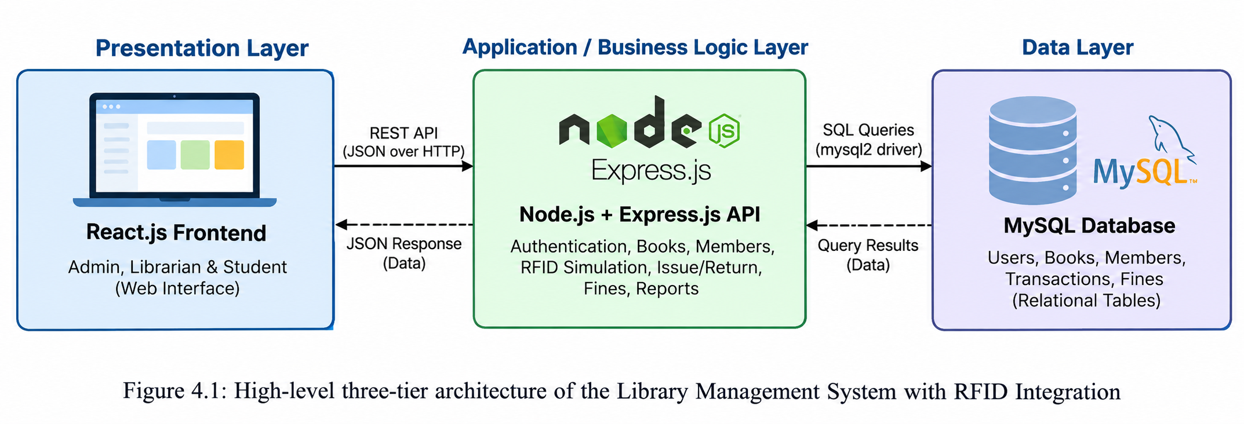
CHAPTER 4: SYSTEM ARCHITECTURE
4.1 High-Level Architecture Diagram
The Library Management System with RFID Integration follows a standard three-tier architecture that separates the user interface, application/business logic, and database. The React-based frontend communicates with the Node.js and Express.js backend through REST APIs, while the backend communicates with the MySQL database using mysql2. The database stores and manages information related to users, books, members, transactions, and fines. The processed results are returned from the database through the backend as JSON responses and displayed on the React frontend.
.
4.2 Description of Each Layer
The Presentation Layer is the React.js single-page application used by administrators, librarians, and students. It provides the user interface for login, dashboard, book management, member management, RFID simulation, issue and return operations, fines, inventory, reports, and student information. The React frontend does not communicate with MySQL directly. All data is obtained by sending HTTP requests to the REST API provided by the Express backend.
The Application Layer is the Node.js and Express.js REST API. It receives requests from the React frontend, authenticates users, checks their roles and permissions, validates requests, and applies the library's business logic. It handles operations such as adding and managing books and members, issuing and returning books, processing RFID simulator requests, managing fines, and generating dashboard statistics. The backend communicates with MySQL through the mysql2 driver and sends the results back to the frontend as JSON responses.
The Data Layer is the MySQL relational database named library_rfid. It stores the persistent information required by the system, including users, books, members, transactions, and fines. Primary keys and foreign keys are used to maintain relationships between the tables, while SQL queries are used to insert, retrieve, update, and delete data.
4.3 Deployment Architecture
For development and demonstration, the three layers of the Library Management System run as separate local services on the same computer. The Node.js and Express backend runs on port 5000, the React/Vite frontend runs on port 5173, and the MySQL database runs on its default port 3306. The frontend communicates with the backend through HTTP/REST API requests, while the backend communicates with MySQL using mysql2.
The basic running order is to start the MySQL server first, followed by the backend, and then the frontend. The application can then be accessed through http://localhost:5173. The current project uses a local development setup, while physical RFID hardware integration and production/cloud deployment can be considered as future enhancements.

Slide 13
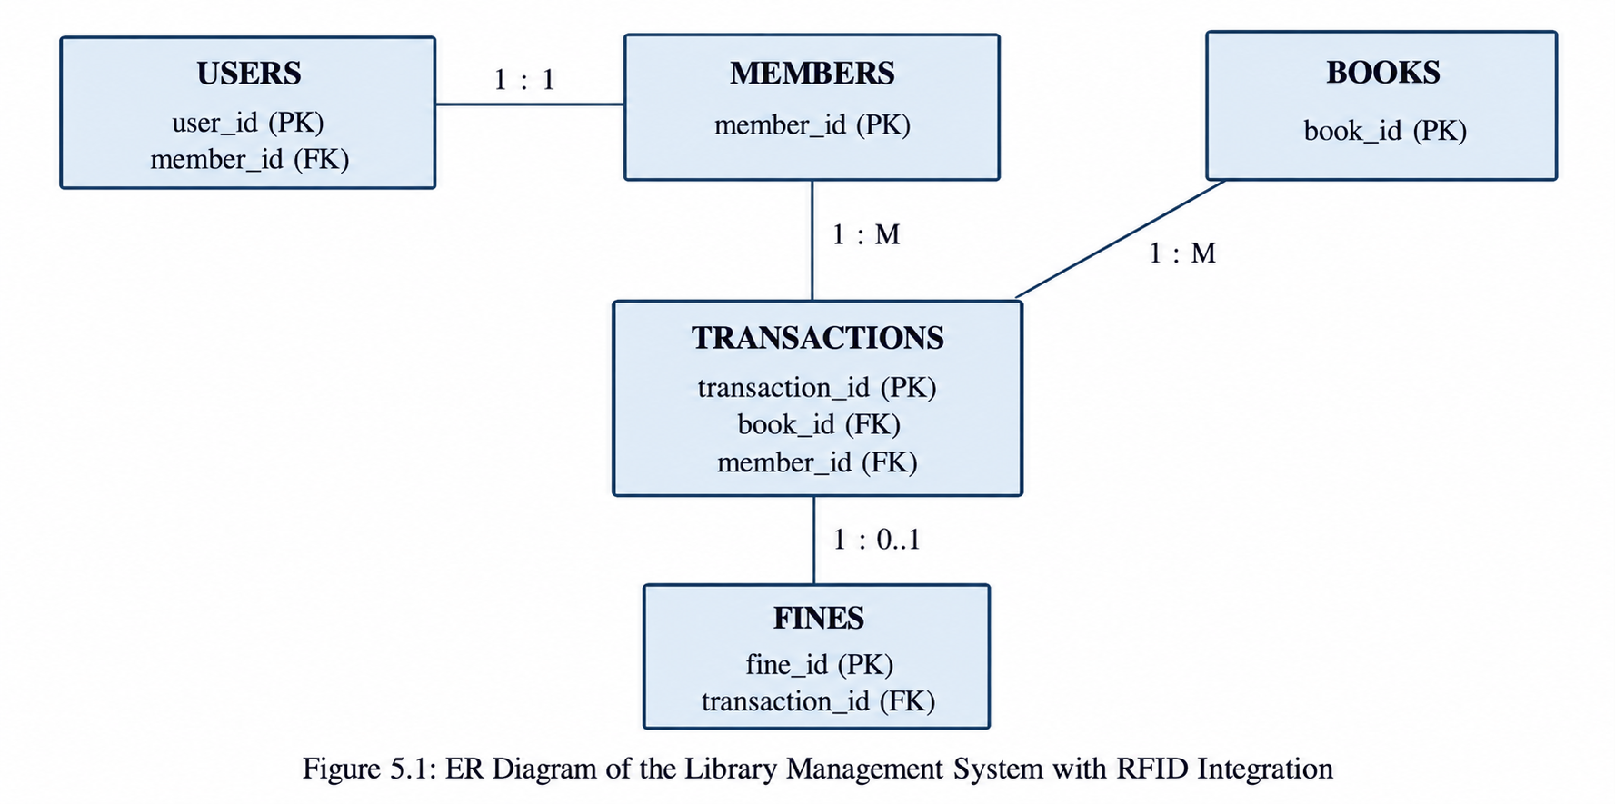
CHAPTER 5: DESIGN
  Database Design Principles
The database schema of the Library Management System with RFID Integration is designed to organize library information efficiently and reduce unnecessary duplication of data. Each type of information is stored in its appropriate table, such as users, books, members, transactions, and fines, while relationships between these tables are maintained using primary keys and foreign keys. This makes it easier to manage and retrieve related information without repeatedly storing the same data.
The database uses constraints such as PRIMARY KEY, FOREIGN KEY, UNIQUE, and appropriate validation constraints to maintain data consistency and integrity. For example, each book and member has a unique identifier, transactions are linked to valid books and members, and user information is maintained separately from library circulation records. This ensures that invalid or inconsistent records are prevented as much as possible at the database level.
. ER Diagram / Database Schema
The database consists of seven related tables, shown in Figure 5.1
.
The database consists of five related tables: users, members, books, transactions, and fines. The USERS table stores login details and user roles, while MEMBERS stores library member information. The BOOKS table stores book details, including RFID information and availability. The TRANSACTIONS table records book issue and return activities by connecting books with members. The FINES table stores fine details related to transactions. Primary keys uniquely identify records, while foreign keys maintain relationships between the tables. These relationships help the system manage books, members, circulation, and fines efficiently.
5.3 Design Decisions and Assumptions
Two design decisions were made explicitly to keep the database structure clear and consistent with the implemented system:

Slide 14
USERS vs. MEMBERS: Since both tables contain information related to students, USERS is used for login, authentication, and role information, while MEMBERS stores library-specific member details. Where applicable, a user is linked to a member record through member_id, keeping authentication data separate from library information.
RFID Integration: The RFID functionality is implemented as a software RFID simulator rather than physical RFID hardware. The RFID ID associated with a book is used during the circulation process to demonstrate book identification, while the actual issue and return records are maintained in the TRANSACTIONS table.

Slide 15
CHAPTER 6: IMPLEMENTATION
  Module-wise Implementation
  The backend is organized into different modules for Authentication, Books, Members, RFID, Transactions, Fines, Dashboard, Reports, and Inventory. Each module contains the required routes and backend logic to handle its operations. The system processes requests such as adding books or members, issuing and returning books, identifying books through the RFID simulator, managing fines, and retrieving dashboard statistics. When a book is issued, the system creates a transaction and updates the book's status from Available to Issued. When the book is returned, the transaction is updated, the return date is recorded, the book status changes back to Available, and the applicable fine can be calculated or updated.
  Front-end Logic
  The frontend is developed using React.js and contains separate pages and components for the different library operations. React state is used to manage data displayed on pages such as the dashboard, books, members, RFID scanner, issue/return, fines, inventory, and reports. The frontend communicates with the backend through REST API calls and receives data in JSON format. Reusable React components are used for common interface elements, while the application updates the displayed information dynamically when library operations are performed. This allows users to interact with the system without directly accessing the MySQL database.
  API Integration
  All HTTP requests from the React frontend are sent to the Node.js and Express.js backend through REST APIs. The APIs are used for operations such as managing books, members, RFID identification, transactions, fines, dashboard statistics, reports, and inventory. The backend processes each request, communicates with the MySQL database using mysql2, and returns the required data as a JSON response to the frontend. This keeps the API communication separate from the user interface and database operations.
  Authentication and Authorization
  The system uses JWT for user authentication and bcrypt for password hashing. Users are assigned roles such as Admin, Librarian, or Student, and access to different operations is controlled according to these roles. Protected API routes verify the user's authentication information before allowing access, while authorization ensures that students cannot perform administrative operations. Passwords are stored as hashes rather than plain-text passwords, helping protect user credentials.

Slide 16
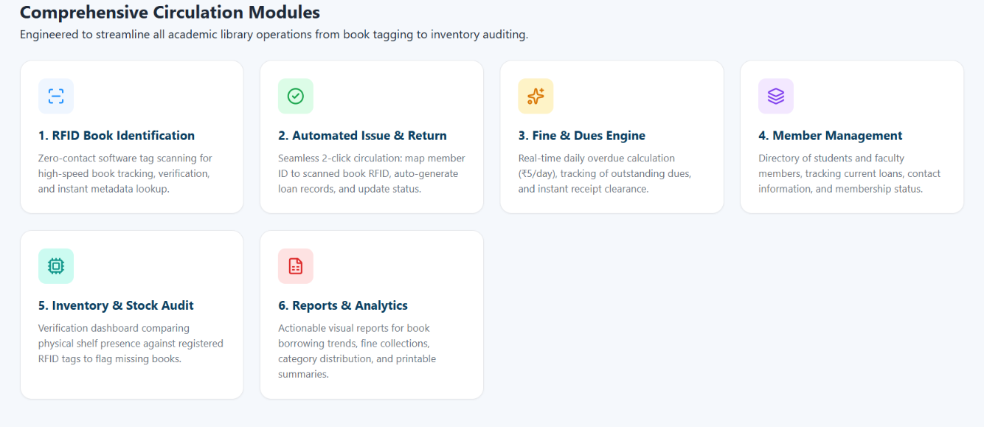
CHAPTER 7: FEATURES
  List of Main Features
Student-facing features:
Browse and search available books.
View book details and availability status.
View borrowed books and transaction history.
View personal fines and dues.
View personal profile information.
Librarian/Admin features:
Add, edit, and manage books.
Add and manage library members.
Issue books and record transactions.
Return books and update their availability status.
Use the software RFID simulator for book identification.
Manage fines and dues.
Verify library inventory and stock.
View dashboard statistics and reports.
Manage user roles and access permissions.
7.2 How Each Feature Works
Book availability checking: The system checks the current status of each book in the database and determines whether it is Available or Issued. The availability information is retrieved from MySQL and displayed through the React frontend.
Occupancy percentage calculation: once an admin records the actual headcount for an event, the system computes (actual_occupancy ÷ room_capacity) × 100 and buckets the result into one of

Slide 17
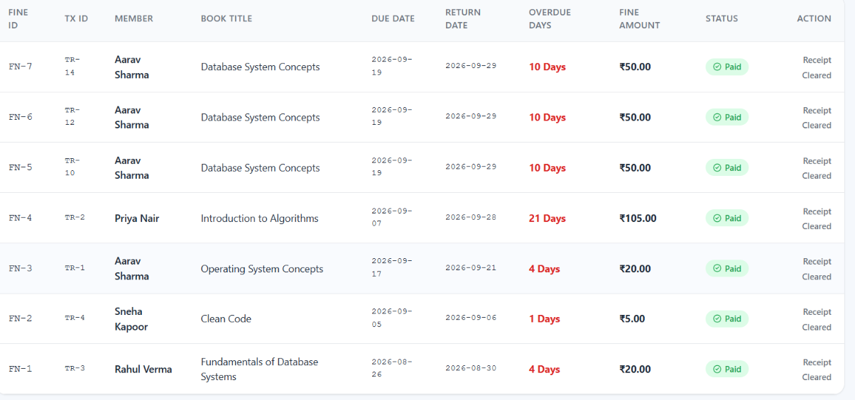
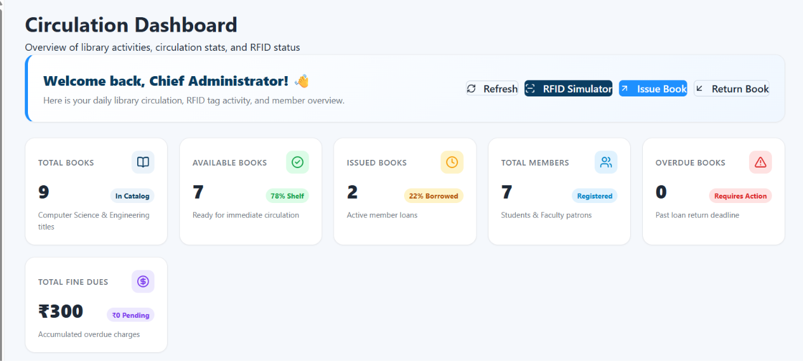
Fine calculation: The system checks the due date and return date of a transaction to determine whether a book is overdue. If the book is returned after the due date, the applicable fine amount is calculated and recorded in the fines table. The fine status and amount can then be displayed to the authorized user..
Dashboard statistics: The dashboard dynamically retrieves library statistics from MySQL, such as total books, available books, issued books, total members, overdue books, and total fine dues. These values are updated based on the current database records rather than being hardcoded.

Slide 18
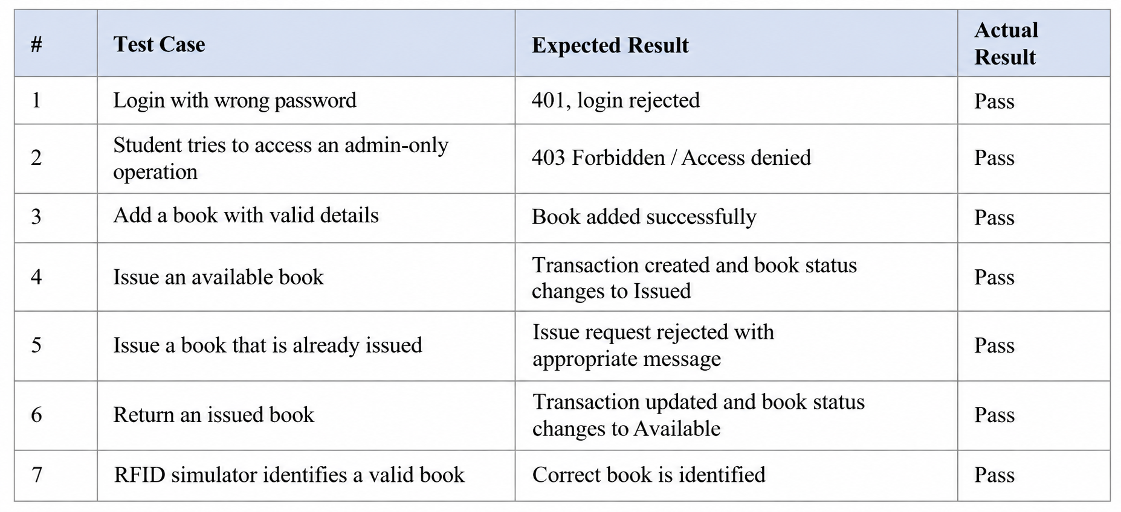
CHAPTER 8: TESTING
  Postman API Testing
  A Postman collection was used to test the REST APIs of the Library Management System with RFID Integration. The APIs for authentication, books, members, RFID, transactions, fines, dashboard, reports, and inventory were tested to verify that requests are processed correctly and the expected responses are returned.
  Integration Testing
The system was tested end-to-end using the React frontend, Node.js and Express.js backend, and a running MySQL database. Each major module was verified to ensure that data entered through the frontend is correctly processed by the backend and stored or retrieved from MySQL. Operations such as adding books and members, issuing and returning books, managing fines, and retrieving dashboard information were checked to ensure that the complete React → Express/Node.js → MySQL workflow functions correctly.
  Tools Used for Testing
Postman — manual and API testing of the backend REST APIs.
MySQL Workbench — direct verification of database tables, records, and queries.
Browser Developer Tools — checking frontend behavior, API requests, and responses.
Manual Browser Testing — verifying the React frontend's functionality and appearance.
8.4 Test Cases and Results
A representative sample of the test cases executed for the Library Management System with RFID Integration is summarized below..

Slide 19
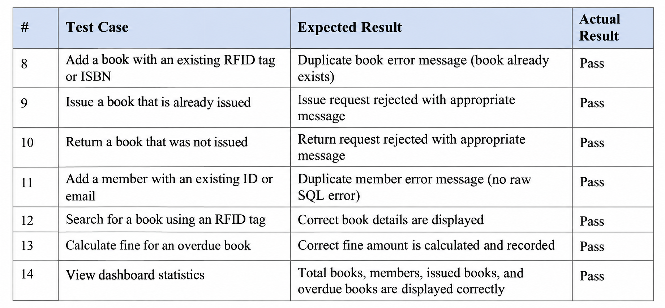
One test also uncovered a real defect rather than confirming correct behavior: pre-filling the Edit Event form's date/time fields initially used the API's raw UTC-encoded timestamp instead of converting it to the browser's local time, which would have shown an incorrect time (for example, 4:30 AM instead of 10:00 AM) on any machine not running in the UTC timezone. This is discussed further in Chapter 10.

Slide 20
CHAPTER 9: DEPLOYMENT
  Steps to Deploy
The application is deployed locally for development and demonstration as follows:
    Load the schema and seed data: mysql -u root -p < database/schema.sql, then ... < database/seed.sql
    Start the backend: cd server, npm install, npm run dev (listens on port 5000)
    Start the frontend: cd client, npm install, npm run dev (listens on port 5173)
    Open http://localhost:5173 in a browser and log in with a seeded account
9.2 Environment Configuration
The backend configuration is maintained using a .env file. It contains configuration values such as the MySQL database host, username, password, database name, backend port, JWT secret, fine-per-day value, and frontend URL. Sensitive credentials and secret keys should not be exposed or committed to the project repository.
9.3 Hosting of Frontend and Backend
For this project, the React frontend, Node.js and Express.js backend, and MySQL database run locally for development and demonstration. The frontend communicates with the backend through REST APIs, while the backend connects to the MySQL database using mysql2. A production or cloud deployment is outside the current implementation and can be considered as a future enhancement. .

Slide 21
CHAPTER 10: CHALLENGES & LIMITATIONS
  Issues Faced During Development
Managing the connection between the React frontend, Node.js/Express backend, and MySQL database.
Maintaining consistency between book status and transaction records during issue and return operations.
Handling authentication and role-based access for Admin, Librarian, and Student users.
Implementing the RFID functionality as a software simulator instead of physical RFID hardware.
Ensuring dashboard statistics are retrieved dynamically from the database rather than using fixed values.
  Solutions Applied
  The frontend-backend communication was organized through REST APIs, with the Express backend handling business logic and database operations through mysql2. Book issue and return operations update both the transaction records and book availability status so that the information remains consistent. JWT was implemented for authentication, while bcrypt is used for password hashing and role-based authorization controls access to protected operations. The RFID functionality was implemented as a software simulator to demonstrate RFID-based book identification. Dashboard statistics are calculated dynamically from the MySQL database.
  Current Limitations or Known Bugs
The project currently uses a software RFID simulator; physical RFID hardware is not connected.
The system is currently designed for local development and demonstration.
Some advanced library features may require further development and testing.
Production/cloud deployment has not been implemented.
Additional security features such as advanced account recovery can be considered for future development.

Slide 22
CHAPTER 11: FUTURE ENHANCEMENTS
  Planned Features
Physical RFID reader integration for automatic book identification.
Email-based notifications for due dates, overdue books, and fine reminders.
Online fine payment functionality.
Advanced search and filtering for books by title, author, category, and availability.
Automated notifications when a borrowed book is approaching its due date.
Enhanced reports and analytics for library usage, book circulation, and fines.
  2. Possible Integrations or Optimizations
Integrating a physical RFID reader with the existing RFID simulator workflow.
Adding a QR-code or barcode scanning option for book identification.
Optimizing frequently used database queries to improve system response time.
Adding cloud deployment for remote access to the library system.
Adding automated testing for backend APIs and frontend functionality to detect errors during future development.

Slide 23
CHAPTER 12: CONCLUSION
  Summary of the Project
The Library Management System with RFID Integration is a full-stack web application developed to centralize and simplify library operations. The system manages books, members, issue and return transactions, fines, inventory, reports, and user access through a React frontend, Node.js and Express.js backend, and MySQL database. A software-based RFID simulator is also included to demonstrate RFID-based book identification.
  What Was Achieved
The completed system provides role-based access for Admin, Librarian, and Student users, manages book and member records, tracks book issue and return transactions, maintains book availability, and manages fines. It also provides dashboard statistics, inventory management, reports, and RFID simulation. The frontend, backend, REST APIs, and MySQL database work together to provide a centralized platform for library management.
  Skills Learned
  Working on this project provided practical experience in relational database design, MySQL, React.js, Node.js, Express.js, REST APIs, and full-stack application development. The project also helped develop an understanding of authentication using JWT, password security using bcrypt, API integration, CRUD operations, database relationships, and connecting a frontend with a backend and database. It also provided experience in testing, debugging, Git/GitHub version control, and implementing a software-based RFID simulation.

Slide 24
CHAPTER 13: REFERENCES
React — Official Documentation, https://react.dev
Vite — Official Documentation, https://vitejs.dev
Node.js — Official Documentation, https://nodejs.org/en/docs
Express.js — Official Documentation, https://expressjs.com
MySQL 8.0 Reference Manual, https://dev.mysql.com/doc/refman/8.0/en/
mysql2 (Node.js MySQL driver) — npm documentation, https://www.npmjs.com/package/mysql2
jsonwebtoken — npm documentation, https://www.npmjs.com/package/jsonwebtoken
bcrypt — npm documentation, https://www.npmjs.com/package/bcrypt
Postman Learning Center, https://learning.postman.com
MDN Web Docs — JavaScript and Web APIs reference, https://developer.mozilla.org

Slide 25

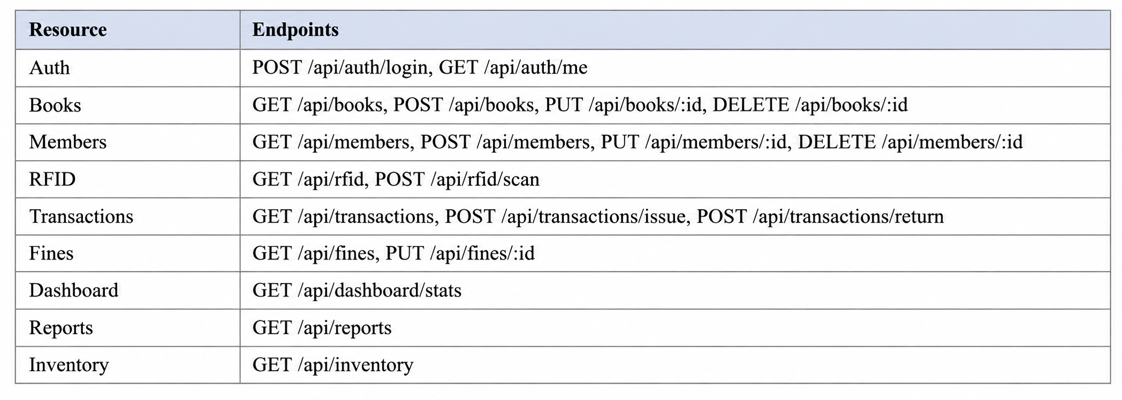
CHAPTER 14: APPENDICES
Appendix A: Sample Code Snippet
The following SQL query is used to retrieve book transaction information by connecting the transactions and books tables::
Appendix B: Installation and Setup Instructions
Start the MySQL server and ensure the library_rfid database is available.
Navigate to the backend folder and run:
npm install
npm run dev
(Backend, port 5000)
Open another terminal, navigate to the frontend folder and run:
npm install
npm run dev
(Frontend, port 5173)
Open http://localhost:5173 in a browser.
Log in using the available user credentials.
Appendix C: Default Login Credentials
All seeded accounts use the password “password123”.
Appendix D: API Reference Summary
The Library Management System provides REST APIs across the main resources used for authentication, books, members, RFID operations, transactions, fines, dashboard statistics, reports, and inventory. The APIs allow the React frontend to communicate with the Node.js and Express.js backend..

Slide 26
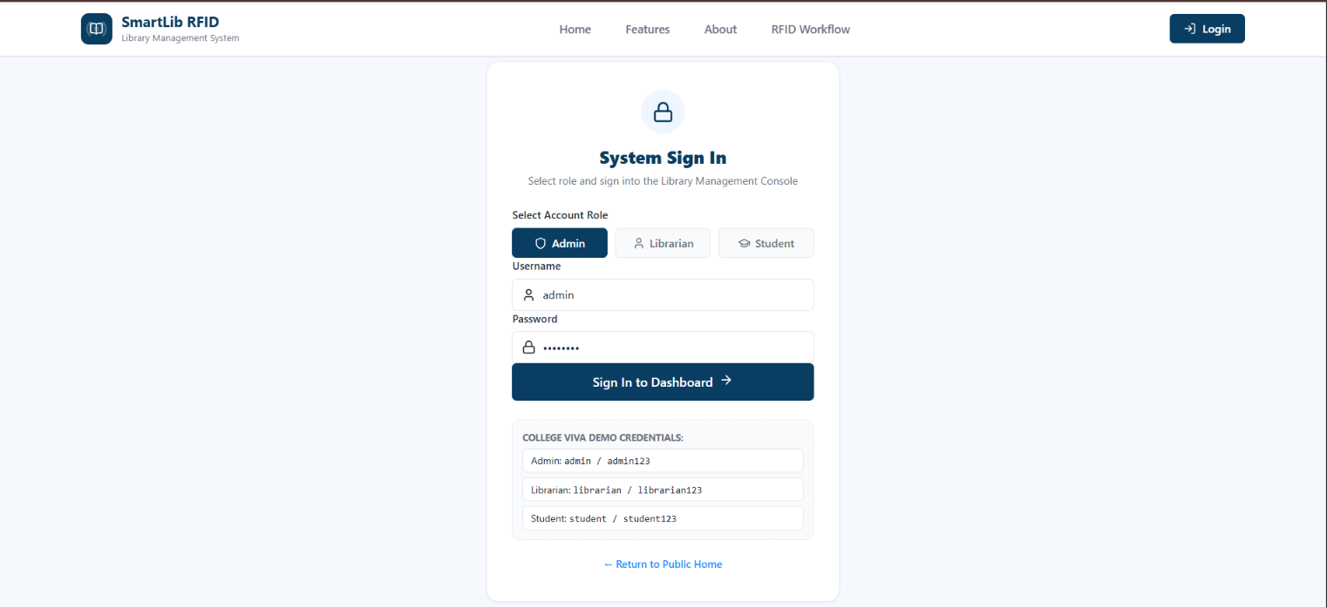
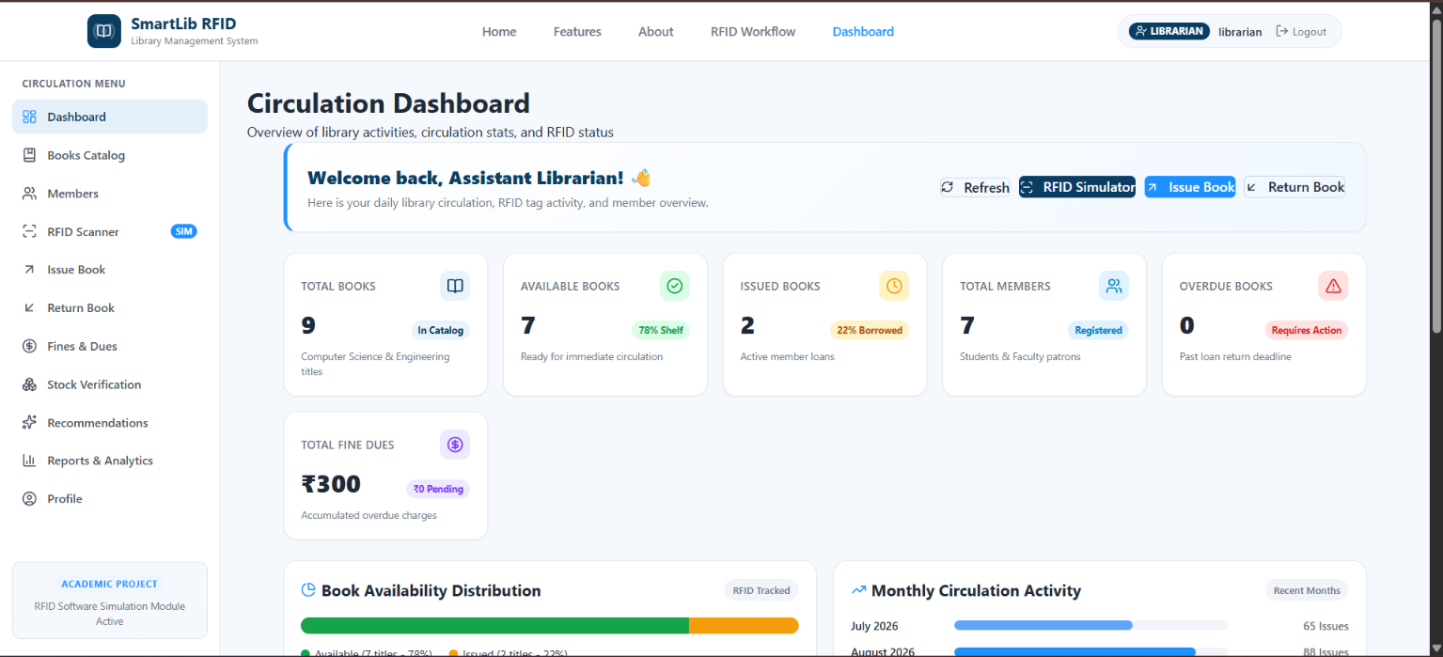
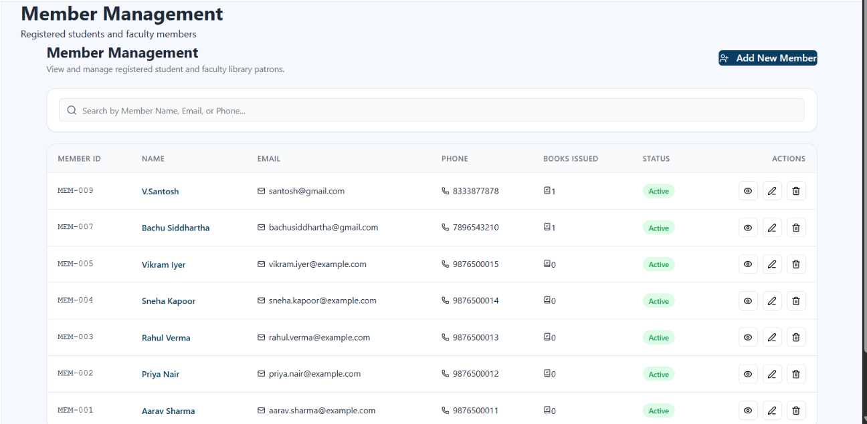
Appendix E: Screenshots
The following pages are left for the student to complete with actual screenshots taken from the running application before submission. Suggested screenshots, in order:
1. Login Page
2. Dashboard
3. Members page

Slide 27
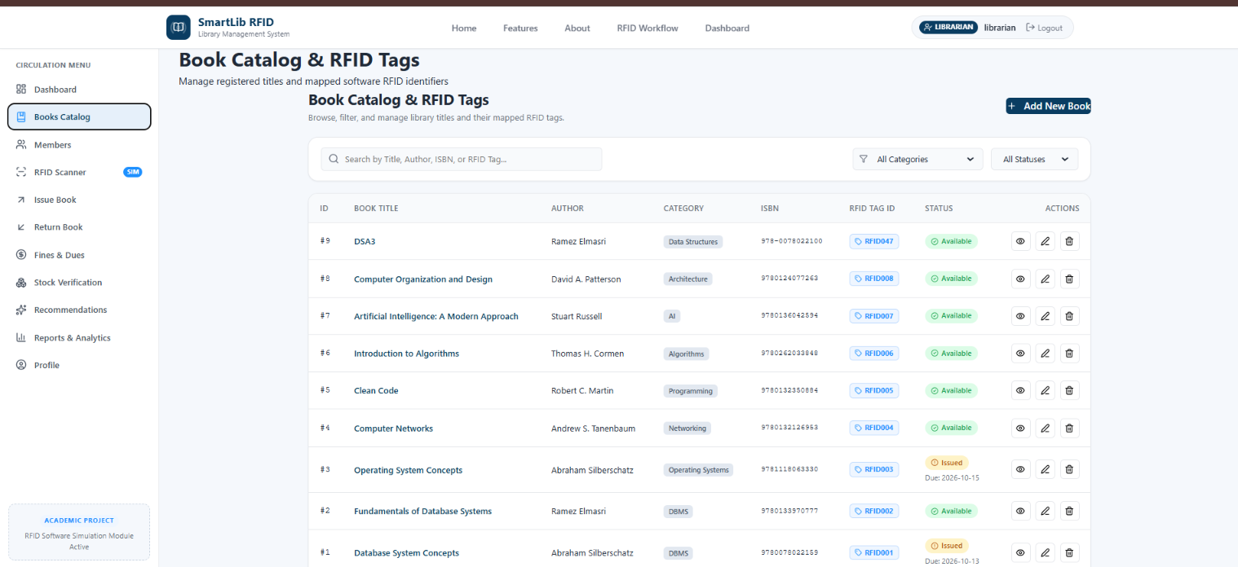
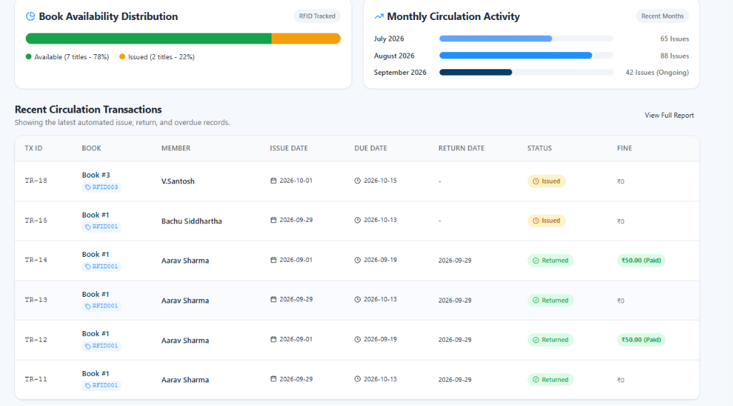
4. Books Catalog Page
5. Admin Dashboard

